Slide 1
Mid-Year fiscal year 2024 budget review
April 2, 2024

Slide 2
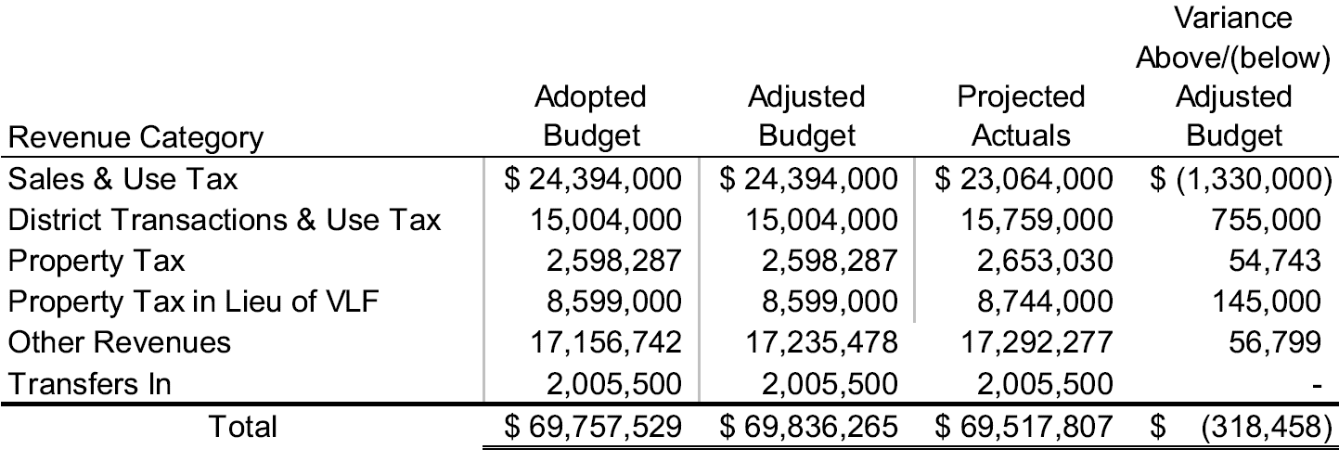
General Fund FY24 Revenues – Adjusted vs Projected

Slide 3
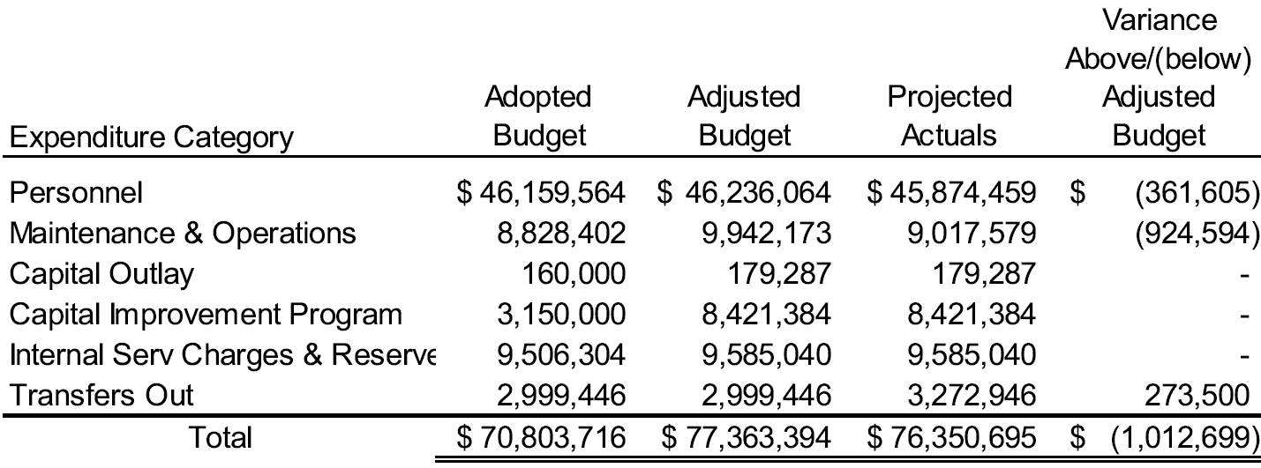
General Fund FY24 Expenditures– Adjusted vs Projected

Slide 4
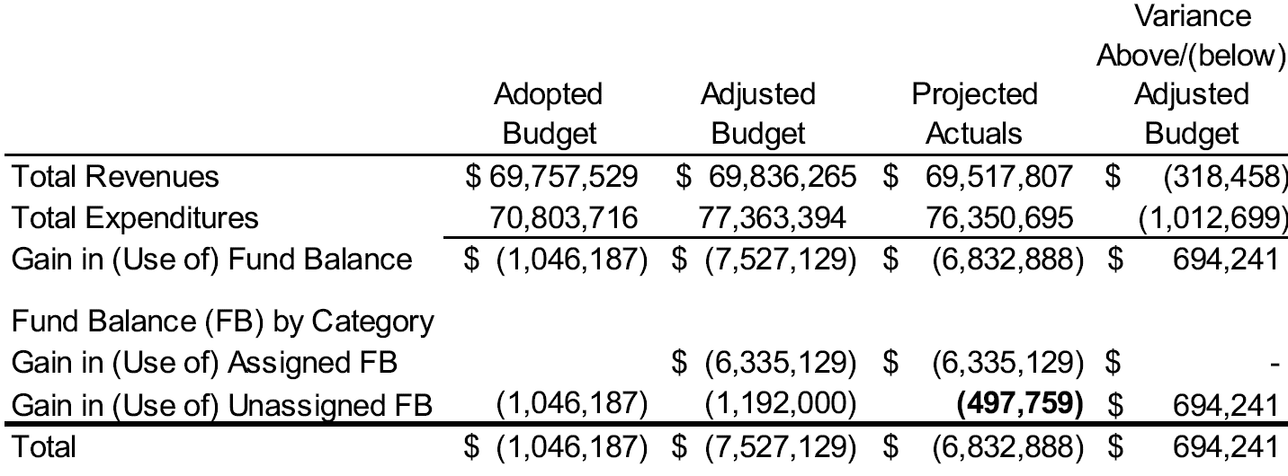
General Fund FY24 Impact on Fund Balance

Slide 5
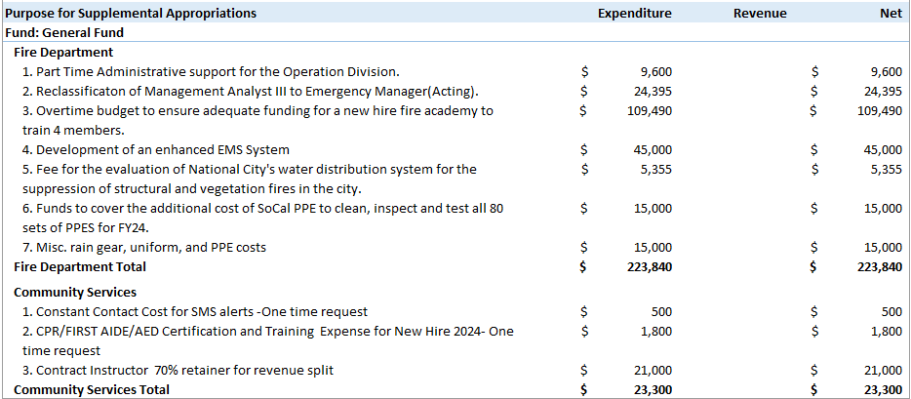
GF Supplemental Appropriations

Slide 6
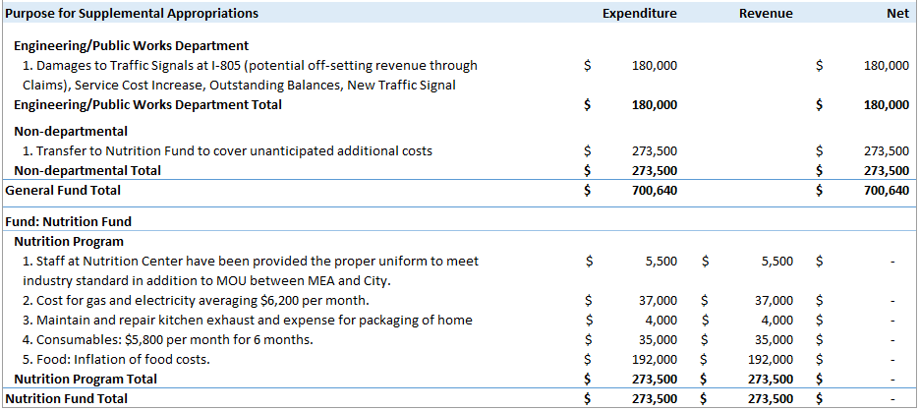
GF Supplemental Approp. - cont

Slide 7
Questions

