Slide 1
Cannabis Development Agreements

Slide 2
Background
2016
Adult Use of Marijuana Act (Prop 64)
2019
Cannabis Community Forum
2020
City Council established a rate of 5% gross receipts fee for all cannabis businesses
Cannabis ordinance delayed due to COVID-19
2021
Cannabis ordinance established
Application process and evaluation criteria established
2022
City Council approved 3 development agreements

Slide 3
Cannabis Application Process
Phase 2 Scoring Criteria
Business Plan (500 points)
Labor, Equity, Diversity & Inclusion Plan (600 points)
Safety Plan (350 points)
Security Plan (350 points)
Qualifications of Owners (400 points)
Neighborhood Compatibility Plan (300 points)
Community Benefits & Investment Plan (400 points)
Proposed Location (100 points)
Phase 1
Determination of Eligibility
Background Checks
Phase 2
Evaluation and scoring
Phase 3
Development Agreement Negotiations
City Council Approval

Slide 4
Applicants
Staff is presenting the last three of the qualifying six cannabis applications.
Mr. Nice Guy
Score of 3,075
Element 7
Score of 3,050
NC Investment Group
Score of 3,000

Slide 5
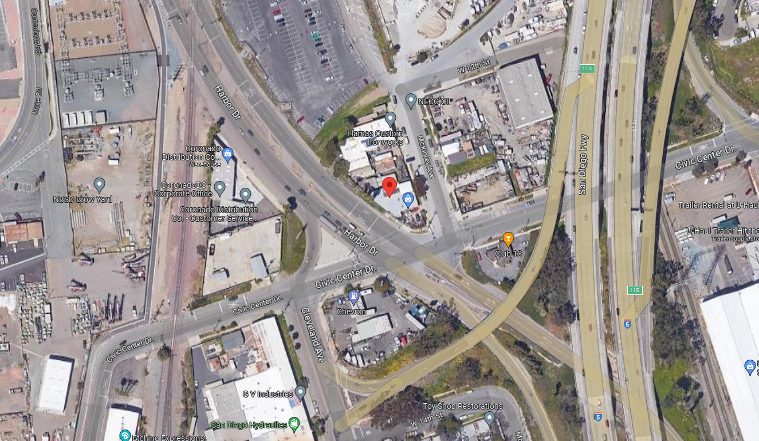
Mr. Nice Guy
Proposed Site
705 Civic Center Drive
Proposed Uses
Microbusiness (retail, manufacturing, and distribution)

Slide 6
Element 7
Proposed Site
3101 Hoover Ave
Proposed Uses
Microbusiness (retail, manufacturing, and distribution)

Slide 7
NC Investment Group
Proposed Site
316 W 30th St
Proposed Uses
Retail storefront & distribution

Slide 8
Joint Development Agreement Negotiations
Staff held joint negotiation meetings with all three (3) applicants for conditions of approval and community benefits
5% gross receipts general fund fee
2% gross receipts general fund fee for distribution activities
National City Community Benefit Fund of 1% net profit
30% local hire
20% hire of previously incarcerated cannabis misdemeanor individuals
1 community clean up event per year
2 drug prevention seminars per year collectively
1 guard minimum during operating hours (unarmed)

Slide 9
Staff Recommendation
Staff is recommending City Council approve all three (3) development agreements and authorize the City Manager to execute the Development Agreements.

Slide 10
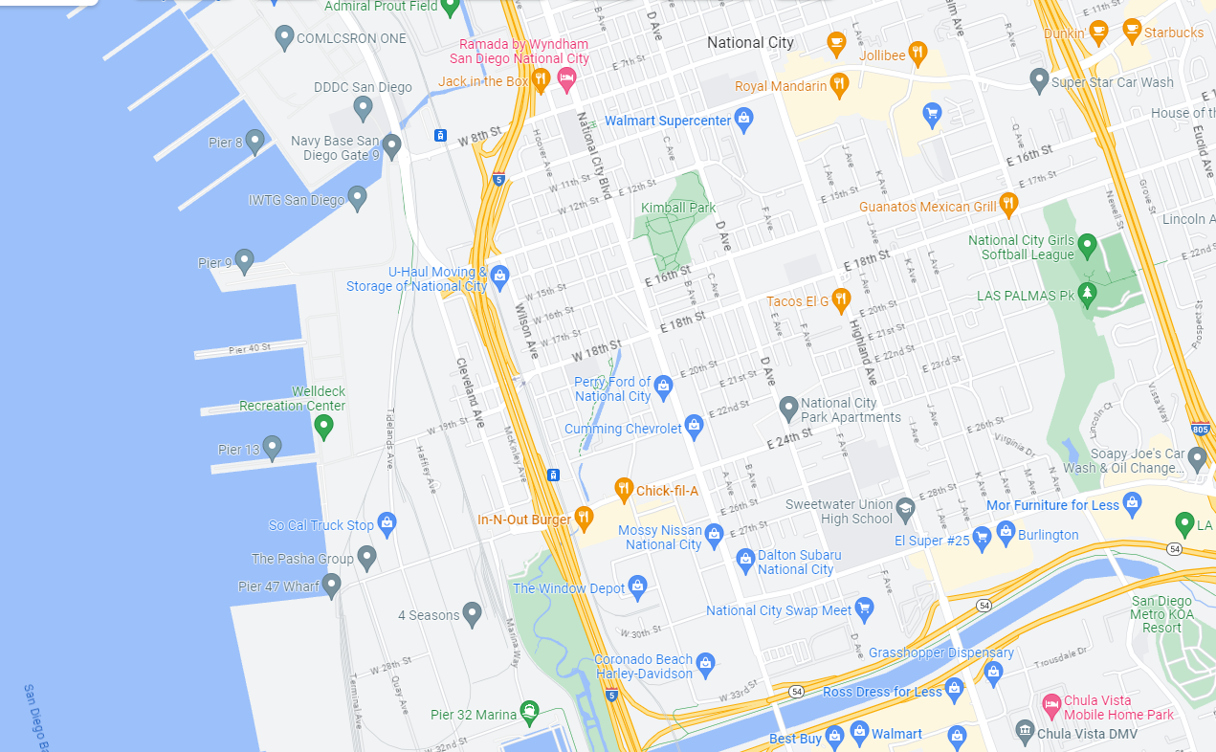
Locations of all cannabis businesses

