Slide 1
FOCUSED GENERAL PLAN UPATE & AFFORDABLE HOUSING NOFA
Carlos Aguirre
Director, National City Housing authority
December 7, 2021

Slide 2
Scope of the Focused General Plan Update
Policies
Housing Element
Land Use Element
Transportation Element
Safety Element
Climate Action Plan
Codes, Ordinances, & Development Standards
Zoning Code
Specific Plans
Objective Design Standards
Focused Policy Updates
Supporting updates to codes, ordinances, and development standards
Environmental review
Environmental Review
Supplemental Program Environmental Impact Report (SEIR)
Notes:
To reflect these changes and address growth, National City is conducting a Focused General Plan Update. The Focused General Plan Update will include updates to policies; supporting updates to codes, ordinances, and development standards; and environmental review.

Slide 3
Project Milestones
Milestone | Date
Project Kick-off Week | March 2020
Community Outreach | August/September 2020
Draft Housing Element | January 2021
Community Outreach | March 2021
24th Street Transit Oriented Development Overlay Approved | June 2021
Housing Element Adopted | August 2021
Housing Element Certified by California Department of Housing and Community Development (HCD) | November 2021

Slide 4
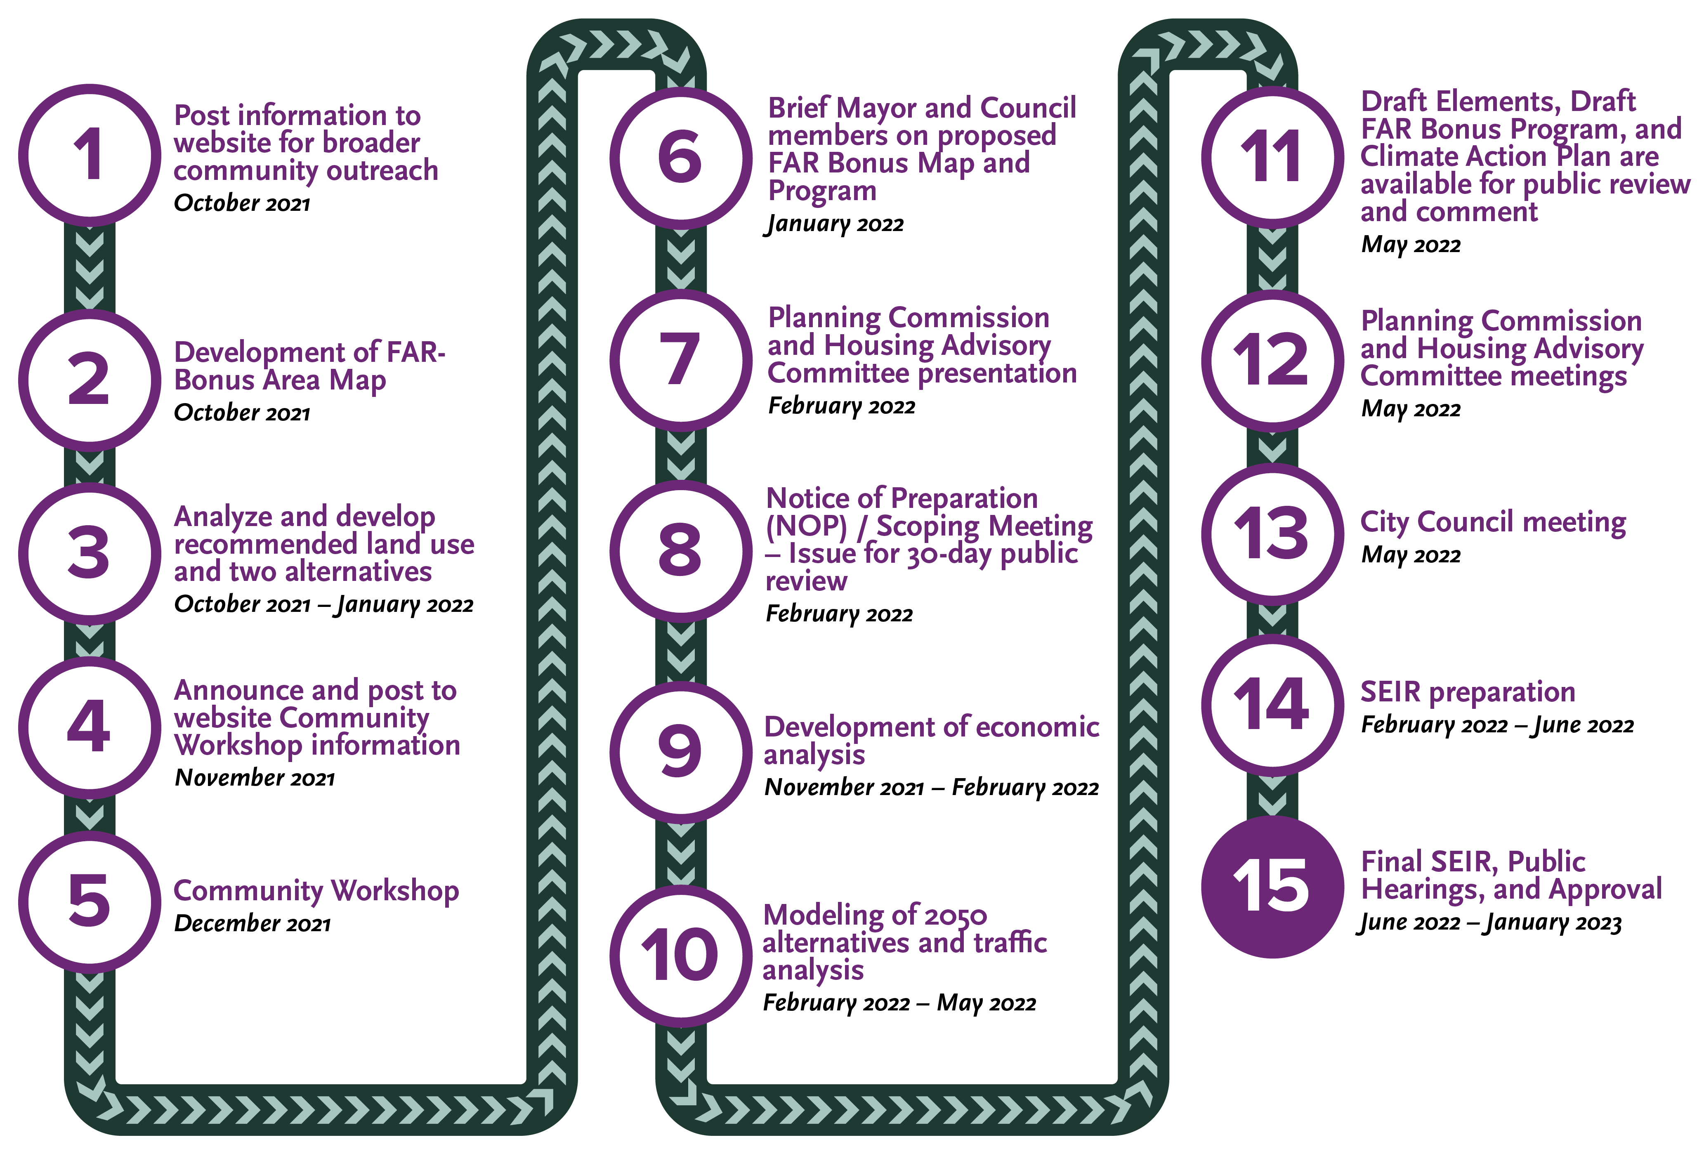
Project Timeline

Slide 5

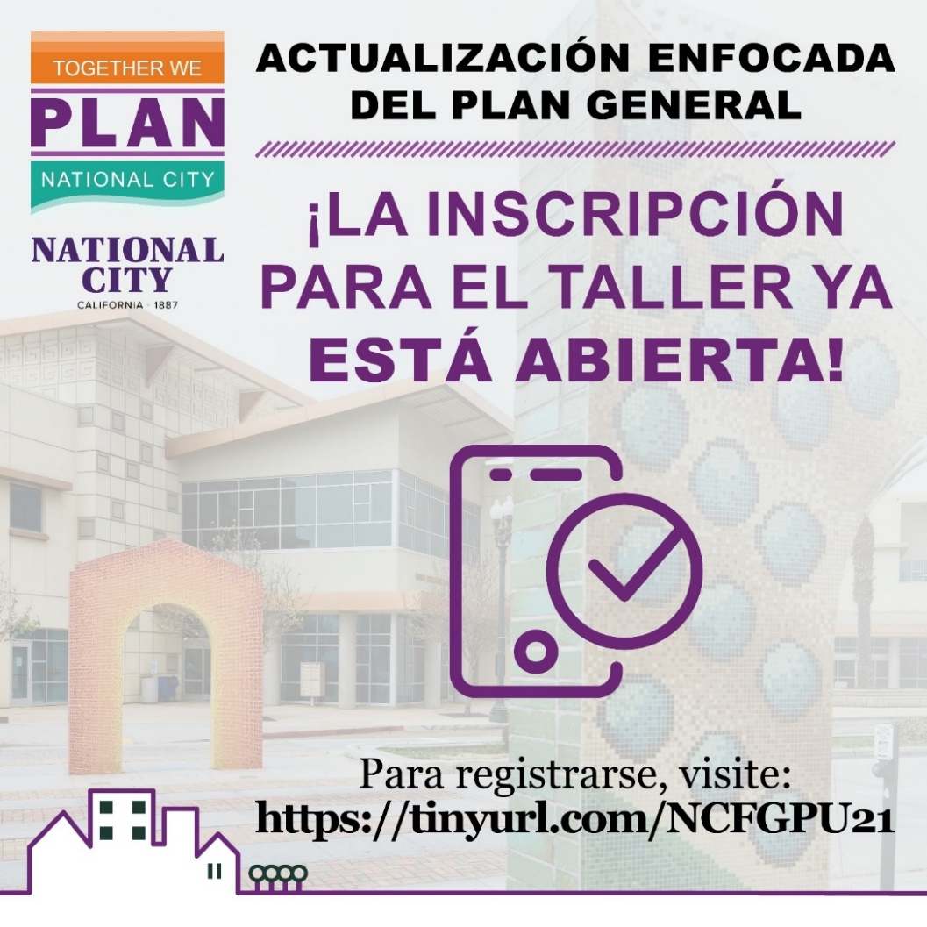
Focus General Plan Update Workshop
Zoom workshop to discuss land use changes, housing incentives, and climate-related goals, policies, and actions. The event is linked on the City’s master calendar.
December 8, 2021
6:30 PM - 8:00 PM

Slide 6
Affordable Housing Notice of Funding Availability (NOFA)
Up to $10 million available through NOFA released on October 18, 2021
Rental projects and home ownership projects
Accepted applications from non-profit and for-profit organizations, joint ventures, or partnerships serving low-income households or those experiencing homelessness
Two project applications received:
  Azuriik Project – 400 Units
  Union Tower – 94 units
AUGUST 2021
NOVEMBER 2021
JANUARY 2022
Goal of the Housing Strategic Plan approved on by the Housing Advisory Committee and City Council
Applications due 11/19/2021 at 5 PM
Application reviewed and scored
Staff recommendations for funding to City Council on Jan. 18
DECEMBER 2021

