Slide 1

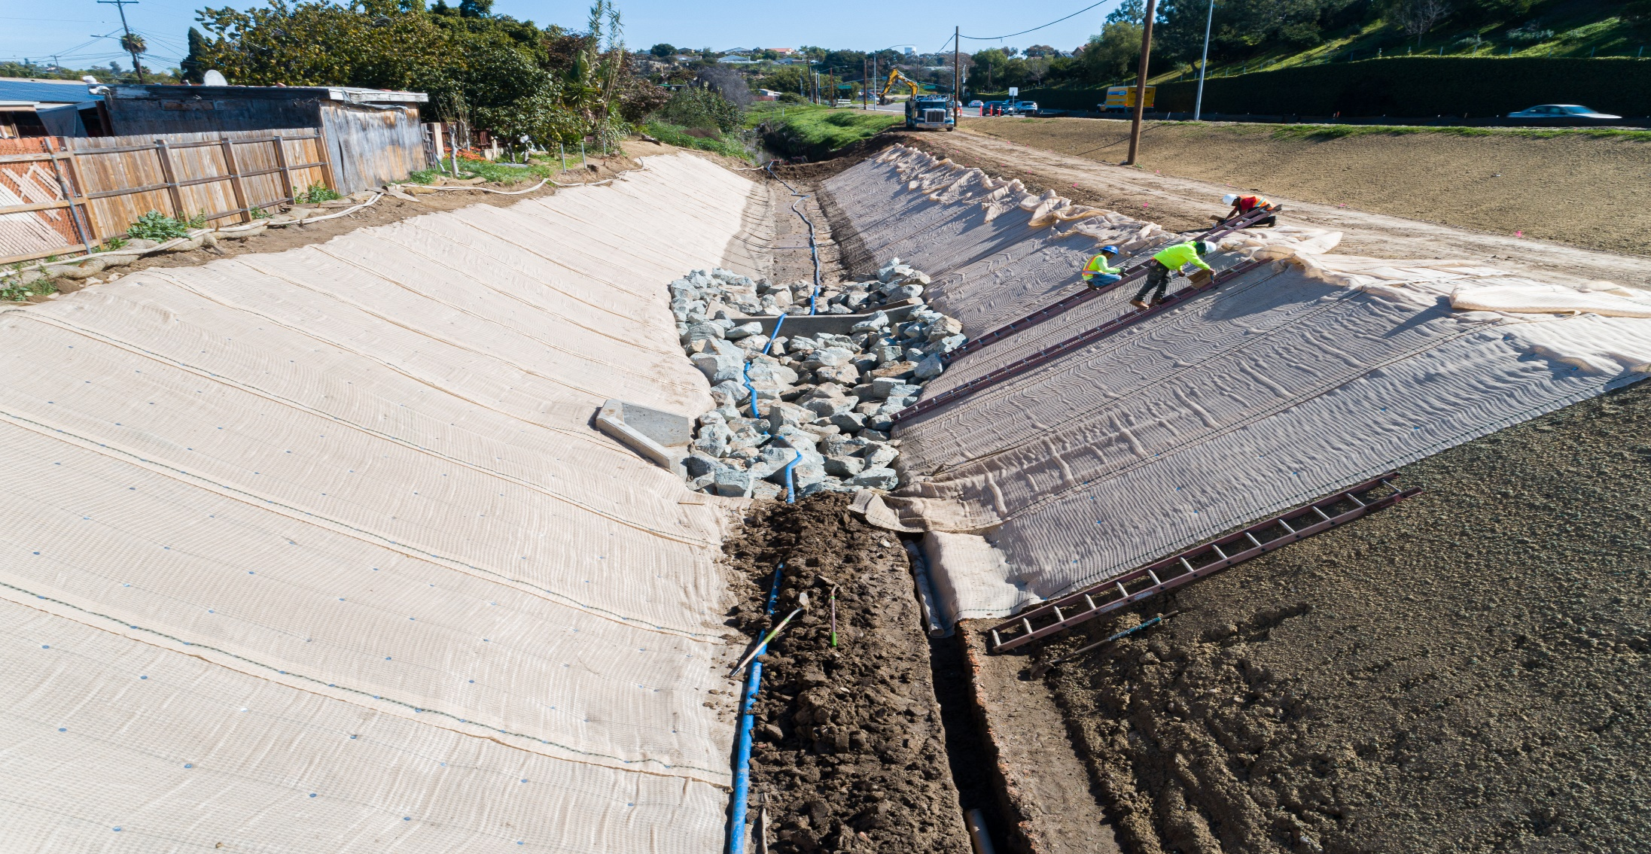




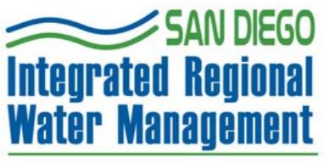
Paradise Creek Water Quality & Community Enhancement project
City Council Meeting
August 3, 2021

Slide 2
2019 San Diego (IRWM) PLAN
The purpose of the 2019 San Diego irwm plan is to:
Improve the reliability and sustainability of regional water supplies;
Protect and enhance water quality;
Protect and enhance our watersheds and natural resources;
Be eligible for State funding through the IRWM grant program for disbursement of over $15M in grant funds for several regional water projects.
Enhance resiliency to climate change for local water resources.
resolution to adopt the 2019 San Diego IRWM Plan in order to allow the City to accept IRWM-related grant funding.

Slide 3
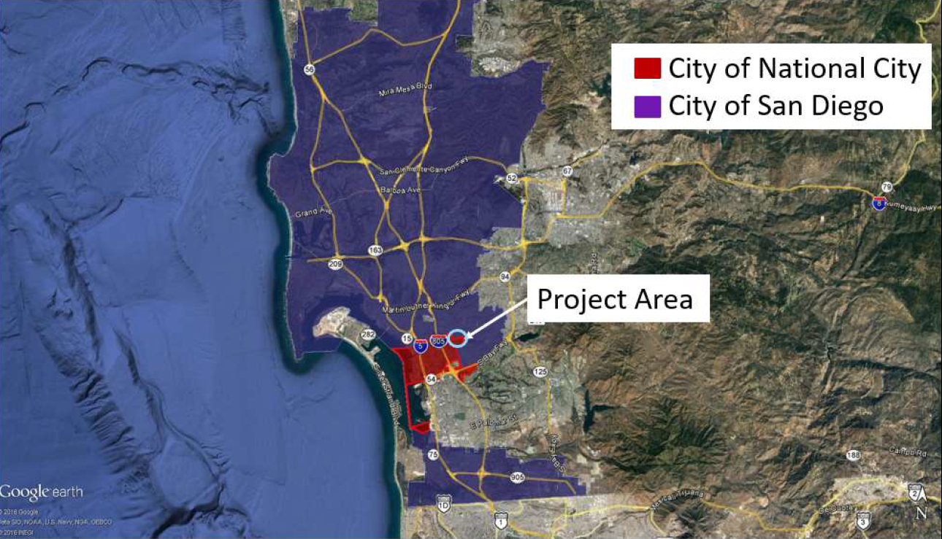
Project Site

Slide 4
Construction Phases
Plaza Blvd
Paradise Valley Rd
Construction Phases:
Phase I – Final contract amount of $1,150,018.95 was completed on June 2020;
Phase II – Estimated total cost $3,681,056.00 – Estimated final construction date Winter 2022;
Phase III - – Estimated total cost $1,600,000.00 – City researching grant opportunities to fund this phase.

Slide 5
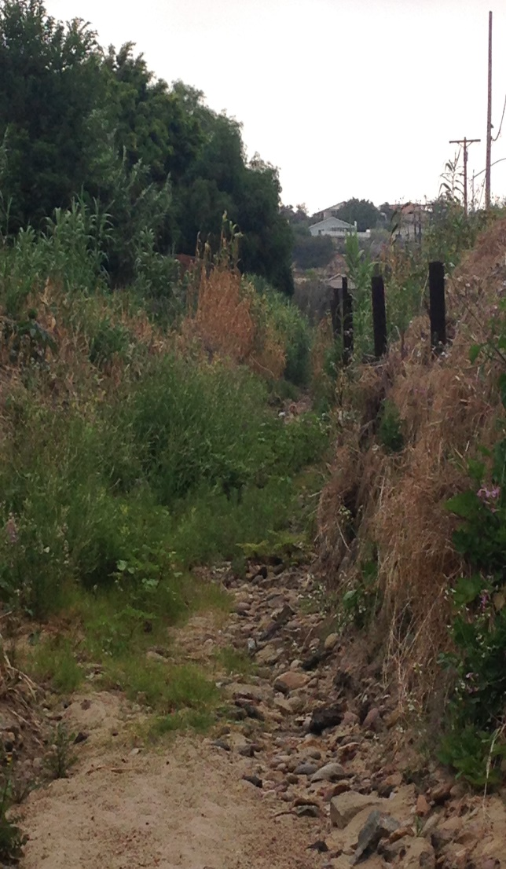
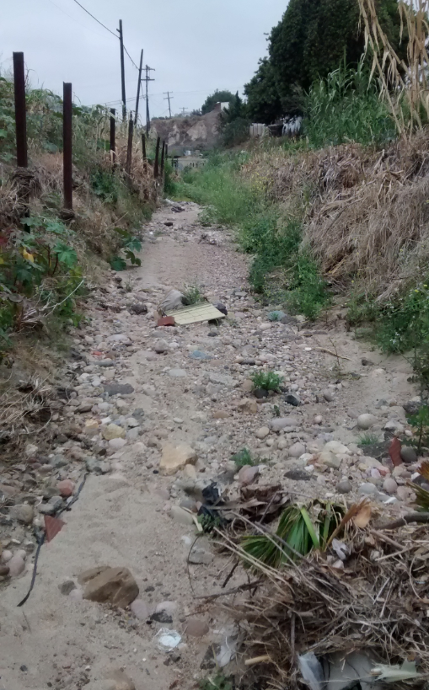
Overall Project Goal for Paradise Creek
Project Goal:
Flood issues;
Erosion control;
Deteriorated channel infrastructure;
Protect and enhance water quality;
Provide access road to maintain the channel
Beautify the area.

Slide 6

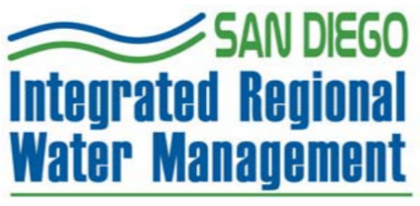








THANK YOU
Roberto Yano
Director Public Works/City Engineer
Engineering/Public Works Department
(619) 336 – 4383
RYano@nationalcityca.gov

Slide 7
QUESTIONS?

