Slide 1
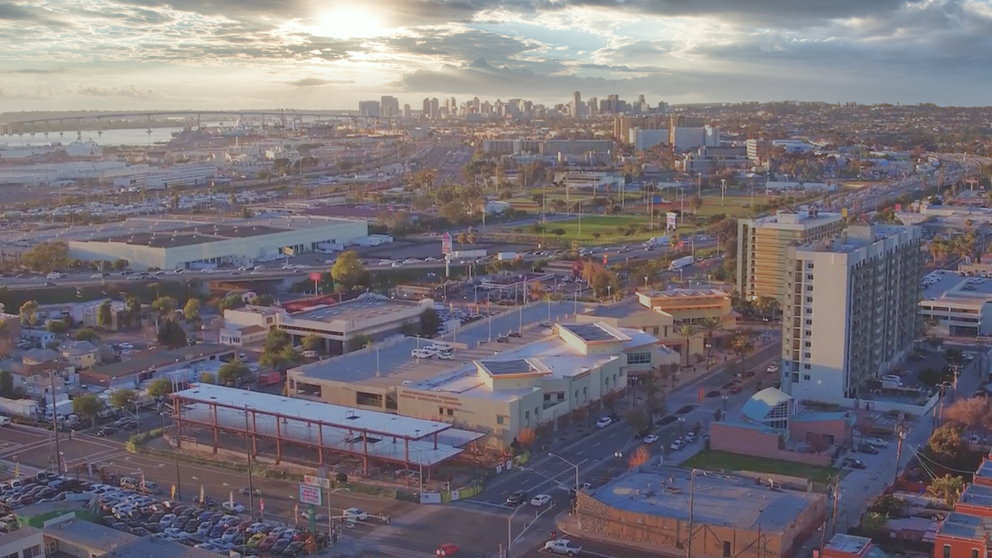
FRANC Free Ride Around National City
Item 24 – August 3rd 2021 City of National City Council Meeting
“Connecting Downtown, Old Town, and the Westside to the Marina District, the Waterfront, Bayshore Bikeway and Naval Base San Diego”

Slide 2
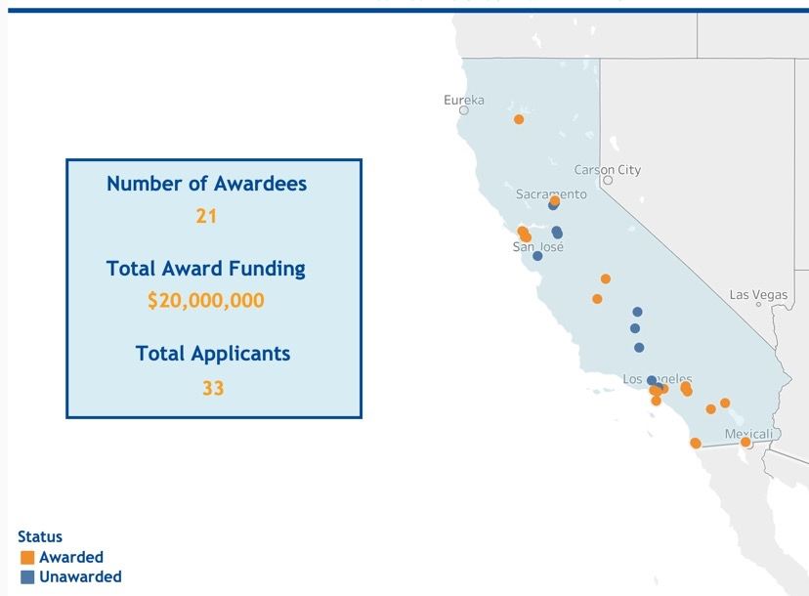
California Air Resources Board
to provide funding for zero emission shared mobility options
National City and Chula Vista only awards in San Diego County

Slide 3
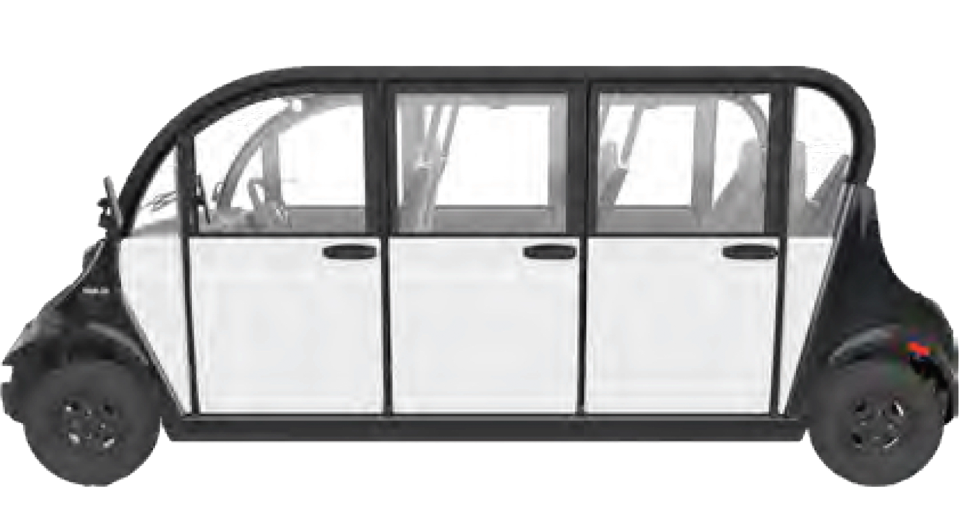
Intended to provide first and last mile connection for trolley station
Connections to destinations in downtown and Westside
Fixed routes / on demand
$999,996
Reimbursement Program
Solar panels on shade structures
2 Neighborhood Electrical Vehicles (NEV)
Cage for overnight storage and recharging
10 Electric bikes
10 electric scooters
Charging station
Free Ride
Around
National City
FRANC

Slide 4
Clean Mobility Option Voucher Pilot Program
Year one – set up
Year two and three – operations paid by program
Year four and five – operations paid by the City
Projected Costs for year four and five $219,000
Possible recovery methods:
revenue from advertisements, micromobility recharging, housing development partnerships, fairbox returns, etc.

Slide 5
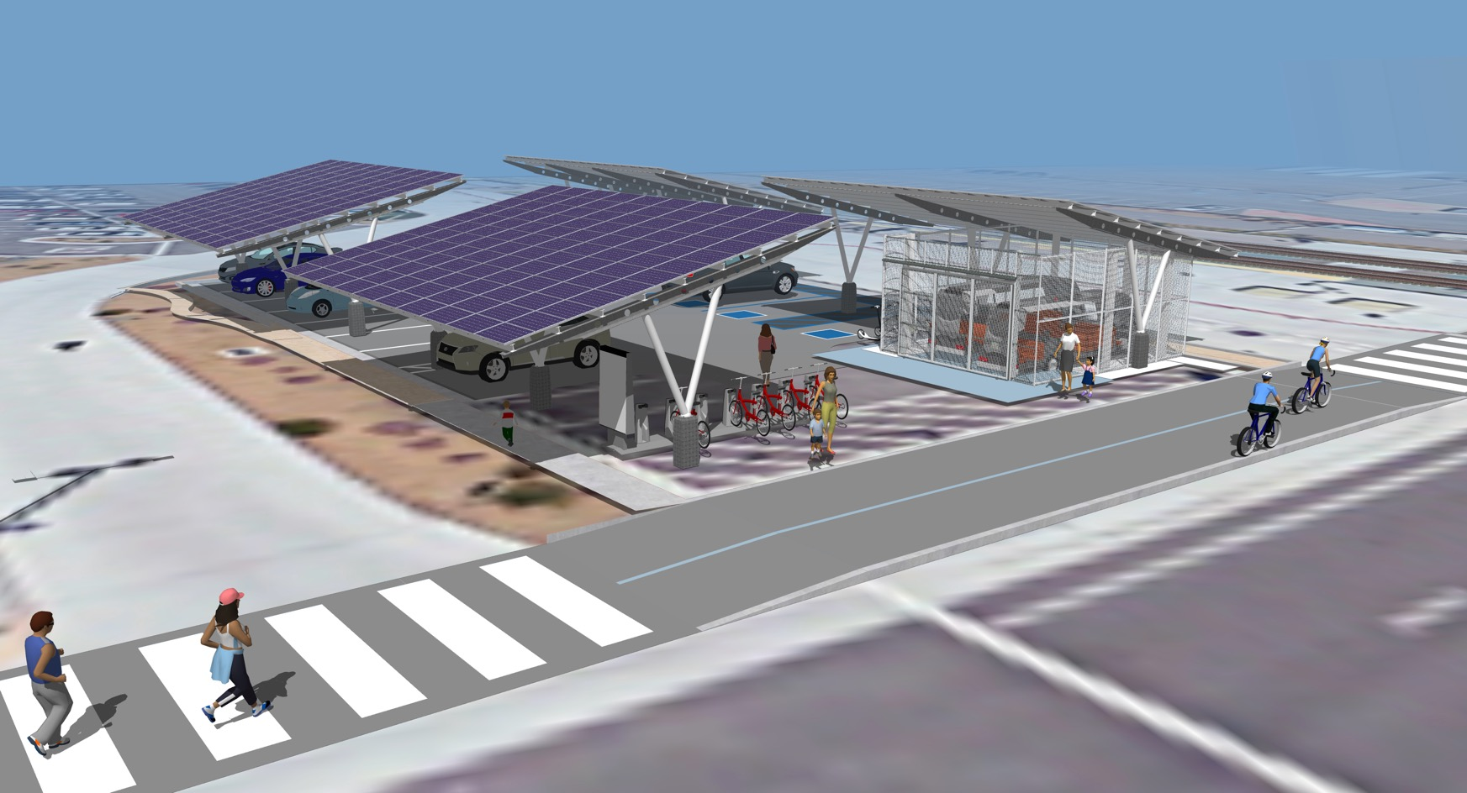
The 8th St. Transit Center Mobility Hub, Photo-voltaic Panels, and Neighborhood Electric Vehicle Shuttle program.

Slide 6
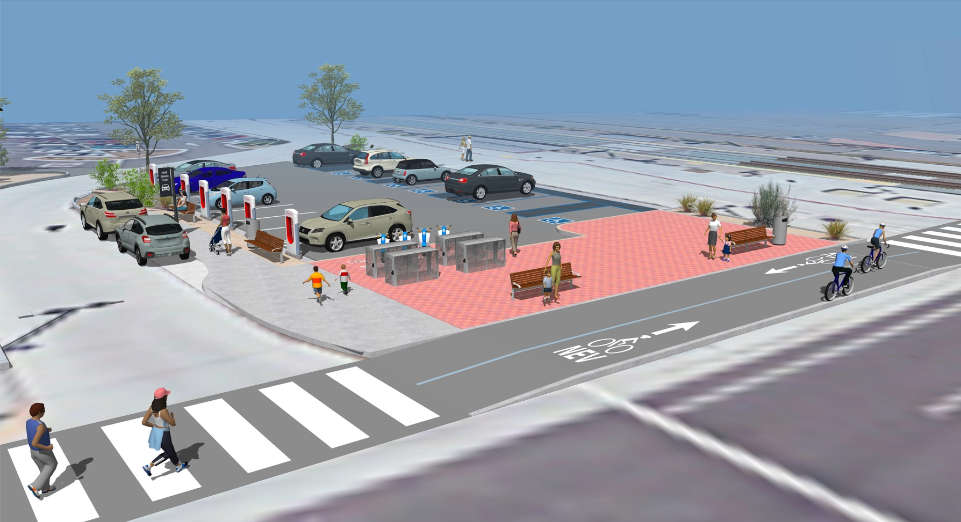
Future Funding Physical Items
• Kiss and ride drop off area
• 6 Level 3 vehicle charging stations
• Bike storage lockers
• Plaza pavers and street furnishings
• Reconfigured exit from drop off

Slide 7
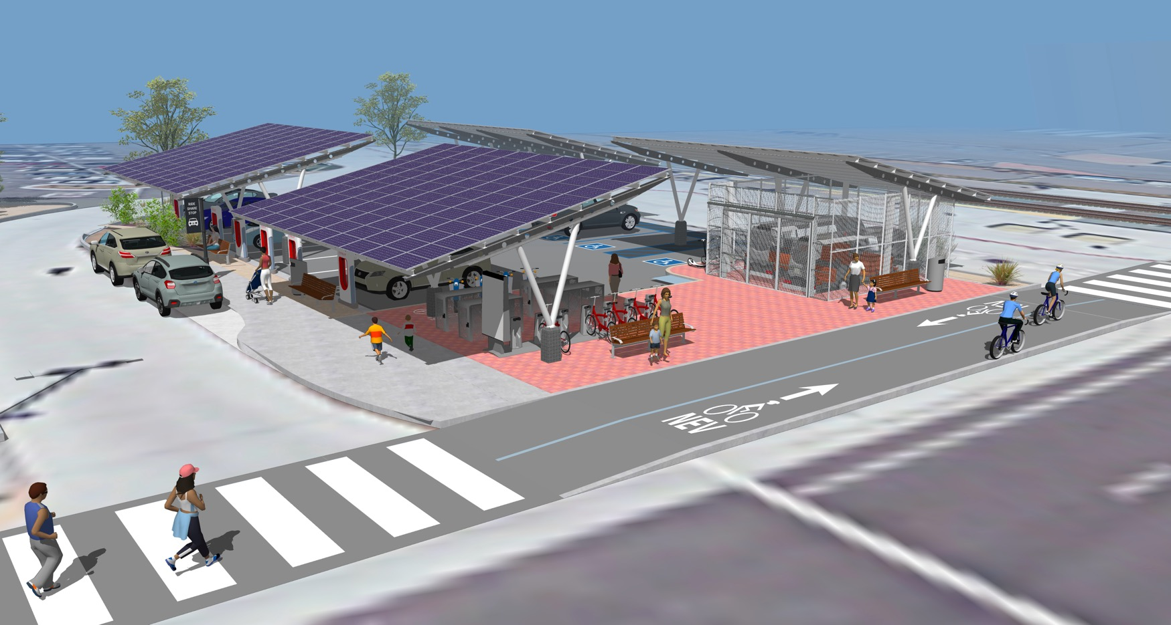
Combined all physical elements

Slide 8
The 8th St. Transit Center Mobility Hub, Photo-voltaic Panels, and Neighborhood Electric Vehicle Shuttle program.

Slide 9
Clean Mobility Option Voucher Pilot Program
The Schedule
3 months period of design and approvals
6 months construction
3 months test, train and manage
The system could come on line for the public around the fall of 2022

Slide 10
Clean Mobility Option Voucher Pilot Program
Staff is recommending adoption of the Resolution:
(1) approving participation in the Clean Mobility Options (CMO) voucher pilot program from the California air resources board for the Free Ride Around National City (FRANC) Neighborhood Electric Vehicle (NEV) system and (2) authorizing the city manager to execute the approval of CMO voucher funds, reiterate CMO program commitment, and compliance with CMO program requirements to the CMO program administrator team

Slide 11
Questions?
Free Ride
Around
National City
FRANC

