Slide 1
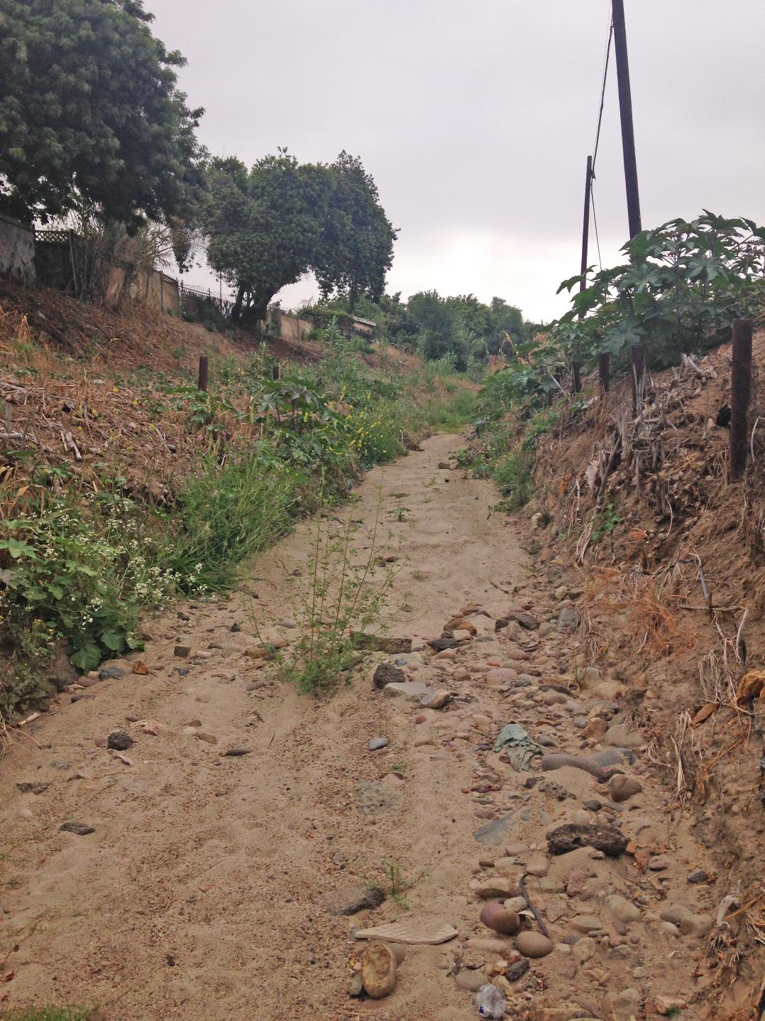
Paradise Creek Water Quality & Community Enhancements Project
City of National City, California
April 11th, 2019

Slide 2
Welcome
A Brief History and the Process
Grants and Funding
Where We Are Now
Proposed Next Steps
What You Can Do
Looking southwest towards Paradise Valley Road; properties to the north are directly adjacent to Paradise Creek.
Notes:
10 minutes max

Slide 3
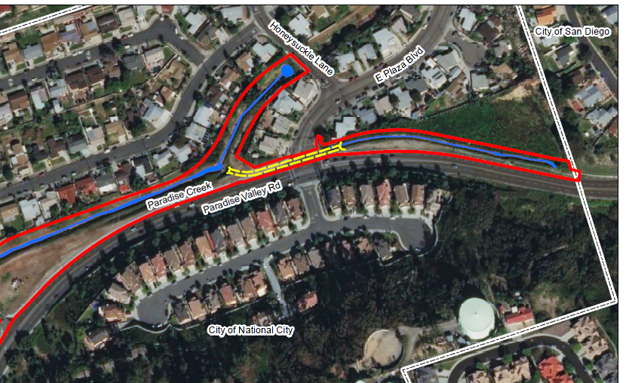
Project site
Notes:
Project areas is on the north side of Paradise Valley Road from Paradise avenue to 700 ft east of East Plaza Blvd
Earthen channel exists between two concrete drainage swales
Make sure to point out the City jurisdiction and diff between CoSD and CoNC- discuss how upstream affects downstream

Slide 4
A brief history and
the Process
Identify a Project Need
Determine Funding Sources
Project Design
Project Studies
Implementation

Slide 5
A Brief History/Project Goals
Paradise creek
Current Issues:
Channel exists in a federally regulated floodway and an identified 100-Year flood plain
Project site is located downstream of two channels and an adjacent street that confluences
Channel is currently tough to maintain
Notes:
Channel has been a large contributor of water quality impairment to the entire watershed.
The project site is at the bottom of a hill that collects SW runoff along the eastern side that confluences with stormwater runoff from E Plaza Blvd.
The channel is difficult to maintain because…..
Define Floodway and what is bad about this
Discuss issues that were being faced
Define the floodway and show them how it affect adjacent properties and roadways

Slide 6
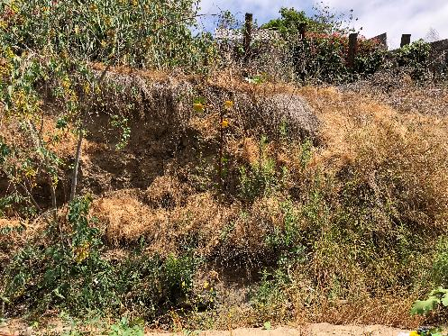
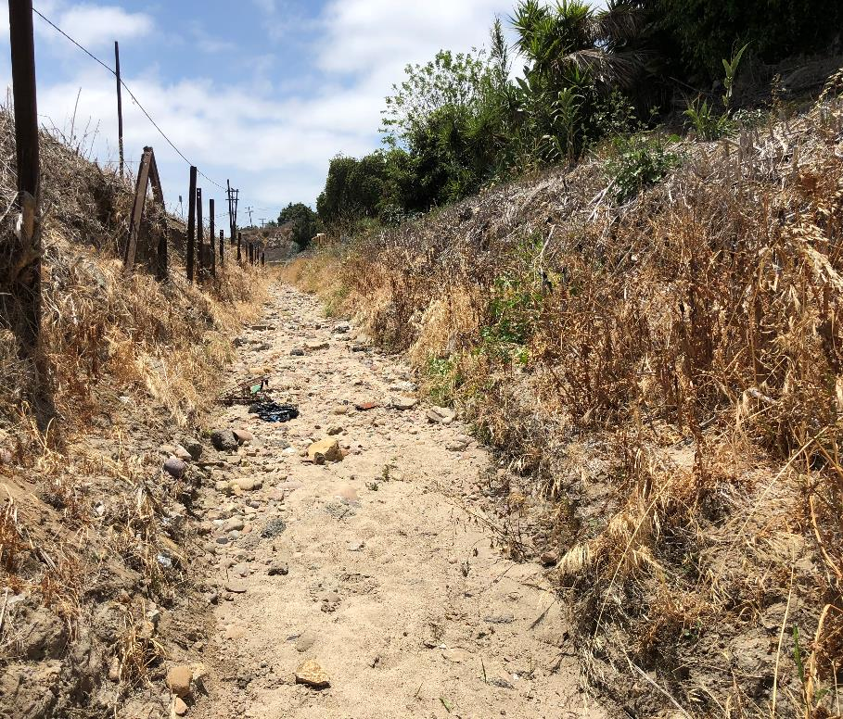
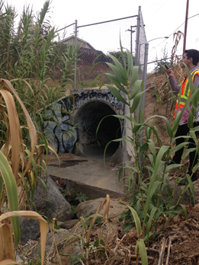
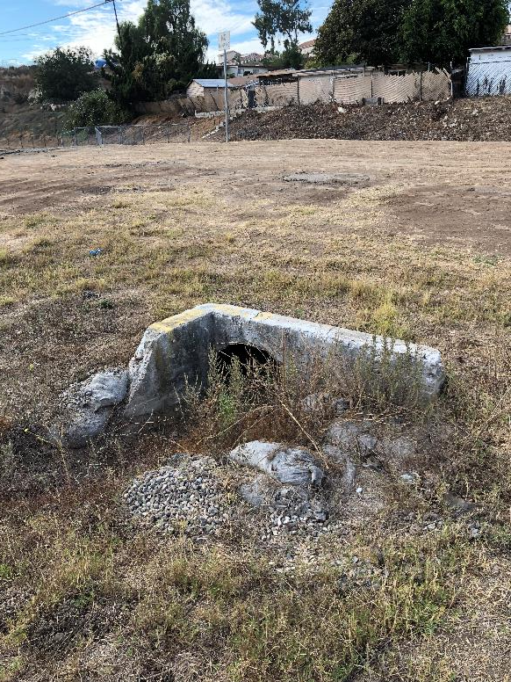
The project site
Paradise creek
Notes:
Left to right:
1. The thin channel that promotes high flow/erosive velocities
2. Undercut side slopes Slopes
3. Culvert surrounded by debris
3. Currently at the location of proposed detention basin. Describe how our design will improve. Sometimes veg grows and covers this area completely.

Slide 7
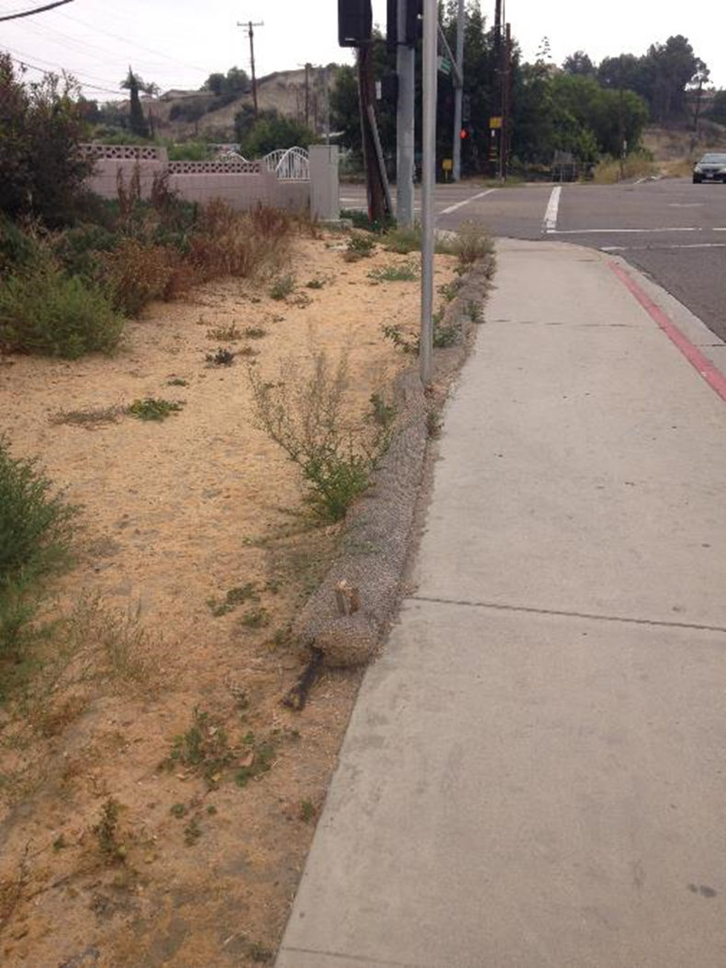
Grants and funding
Proposition 1
2013 San Diego Integrated Regional Water Management (IRWM) Plan
Prop 1 2016 Integrated Regional Water Management (IRWM) Planning Grant
Notes:
Prop 1 Integrated Regional Water Management (IRWM) Grant – Paradise Creek Water Quality and Community Enhancement (Paradise Valley Rd) = $365K
IRWM crosses jurisdictional, watershed, and political boundaries; involves multiple agencies, stakeholders, individuals, and groups; and attempts to address the issues and differing perspectives of all the entities involved through mutually beneficial solutions. They collected XX amount of projects within the San Diego Region and submitted for grant funding as a project.
the priority for this funding is to fund project development activities that will lead to competitive, fundable projects that will leverage implementation grant funding. Completion of planning, design, engineering, and environmental activities that support future capital projects are the priority for this funding opportunity.

Slide 8
Project goals
Identifying the key driving factors
Improve Water Quality
Address
Flooding
HIGH-VOLUME
SURFACE RUNOFF
Recreational
space
The bioswale creek will filter out small levels of pollutants
The water quality basin will provide flow-through treatment
Increase the capacity of the creek and will add an inlet to efficiently convey the 100-year peak flood
Improvements will help to better control the flow
The creek will have a low-flow channel that will help to slow down surface runoff flow and better direct it toward the detention basin
Project will include an educational path along the creek for pedestrians and bicyclists
Help preserve and restore the existing open space while providing an aesthetically pleasing solution for the community
Notes:
1-Improve WQ: It will detain stormwater for an extended period to allow for sedimentation. Some dissolved pollutants will be removed via biofiltration, uptake by vegetation, and/or infiltration.
2-The existing creek does not have the capacity to efficiently convey the 100-yr storm event without potential flood damage or hazard to over 30 properties within the community.
3- The detention basin will detain runoff volumes and will collect and convey storm water into the existing storm drain system. The
4- project aims to engage the community

Slide 9
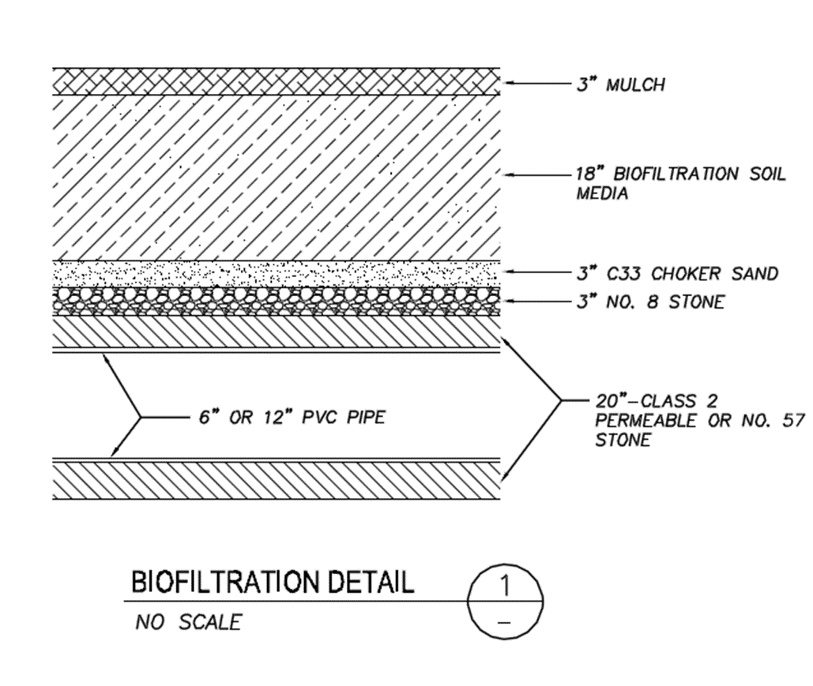
Where are we now
How a biofiltration basin works
Benefits
Slows down runoff
First flush
Treats pollutants

Slide 10
Where we are now
Design Implementations

Slide 11
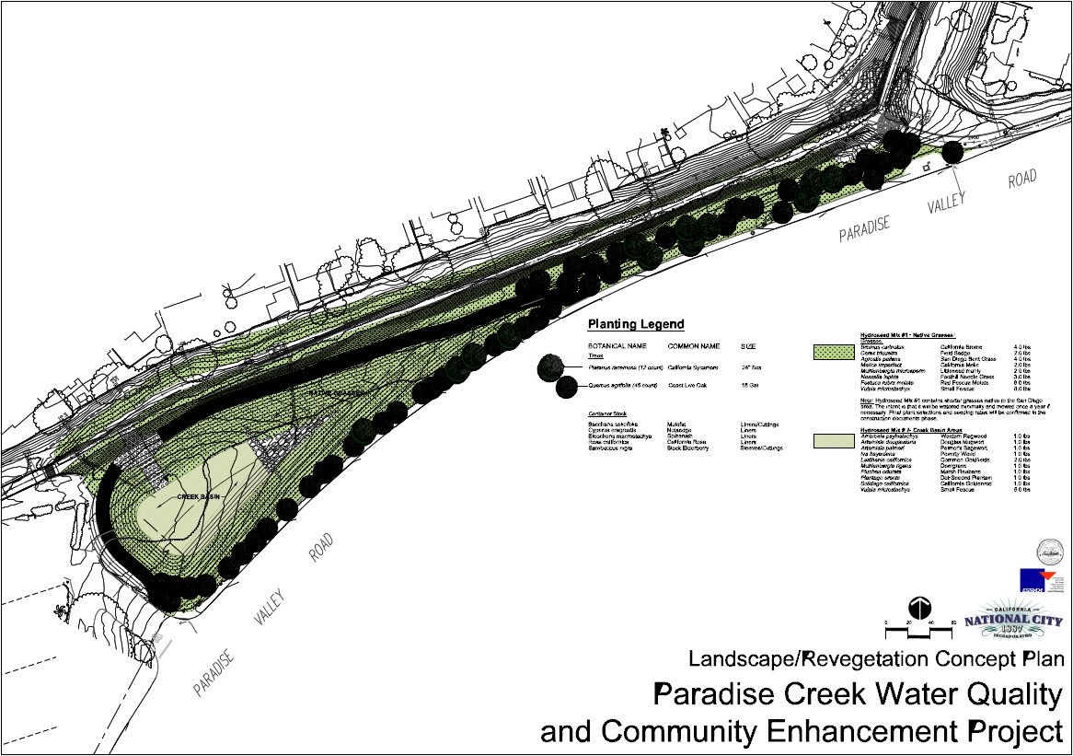
Where we are now Landscape design plan

Slide 12
Proposed next steps
What’s next?
Mailing notices will be distributed to nearby residential properties that may be impacted temporarily by the construction.
The Project’s Construction Contract Documents are being finalized and will be advertised for public bidding this summer (2019) and construction is expected to start in late summer or early fall (2019).
Regulatory permits will be completed and issued shortly (United States Army Corps of Engineers, Regional Water Quality Control Board, and California Department of Fish and Wildlife).

Slide 13
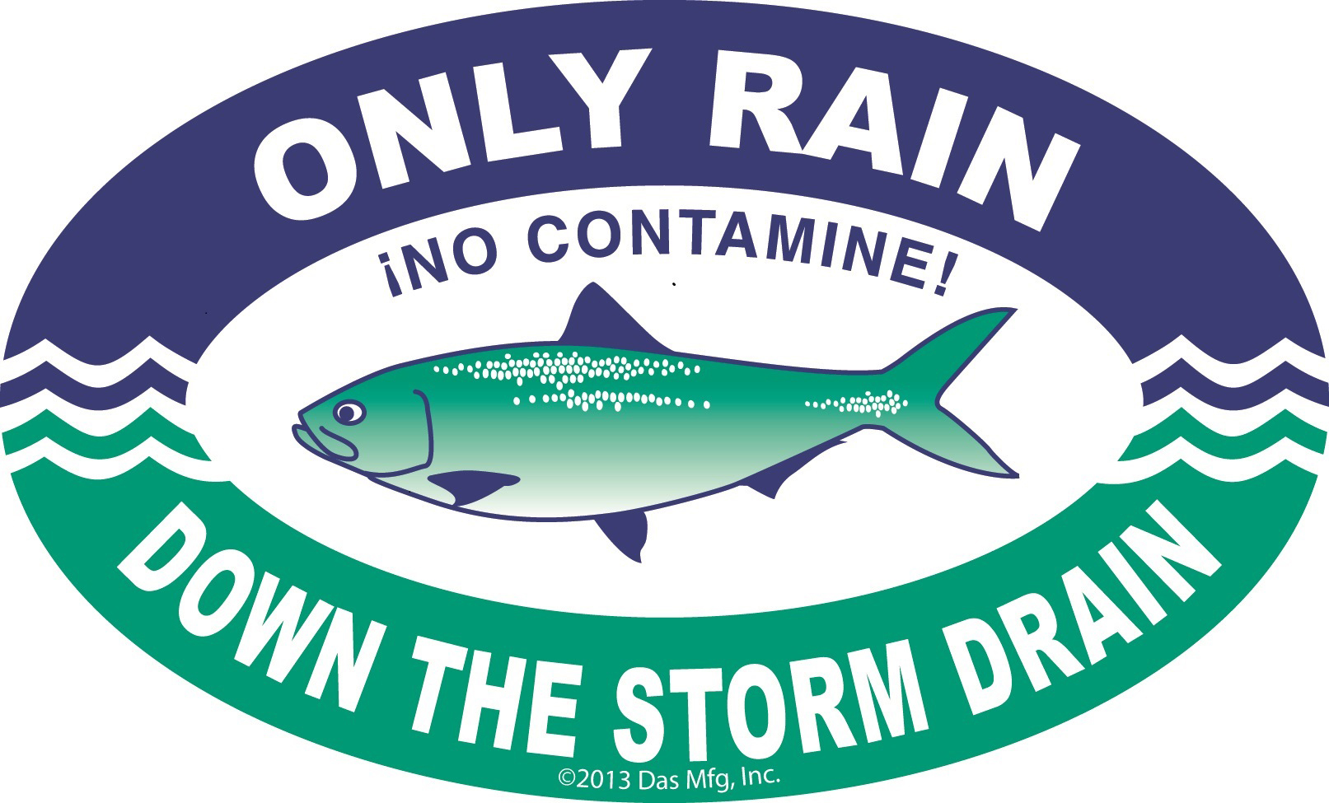
What you can do
Supporting the project
Learn about
Storm water + Native Species
Utilize Sidewalks + Recreational Paths
Participate in Region’s Annual
creek clean ups
The project will include a sidewalk/educational path along the creek for residents and visitors to enjoy the natural habitat.
Help maintain these areas and keep them safe for the public
Flora and fauna
Wildlife
Water quality and the interrelation between water quality, surface water, and groundwater.
Clean and healthy waterways provide a variety of less-tangible benefits such as:
Boosting property values
Minimizing the flood waste that can pollute area waterways and harm wildlife
Beautify local common areas
Notes:
Signage will also iterate the principles of integrated regional water management such as public safety, environmental stewardship,
and economic stability.
Getting your community involved in a neighborhood cleanup can be a great way to create an awareness in your area, and can lay the groundwork for future waste-reducing efforts. A cleanup can also bring about a sense of community and responsibility to keep our homes and common areas safe and clean. Visible results might lead to a heightened interest and involvement among community members in reducing garbage and food waste, and preserving the environment.

Slide 14
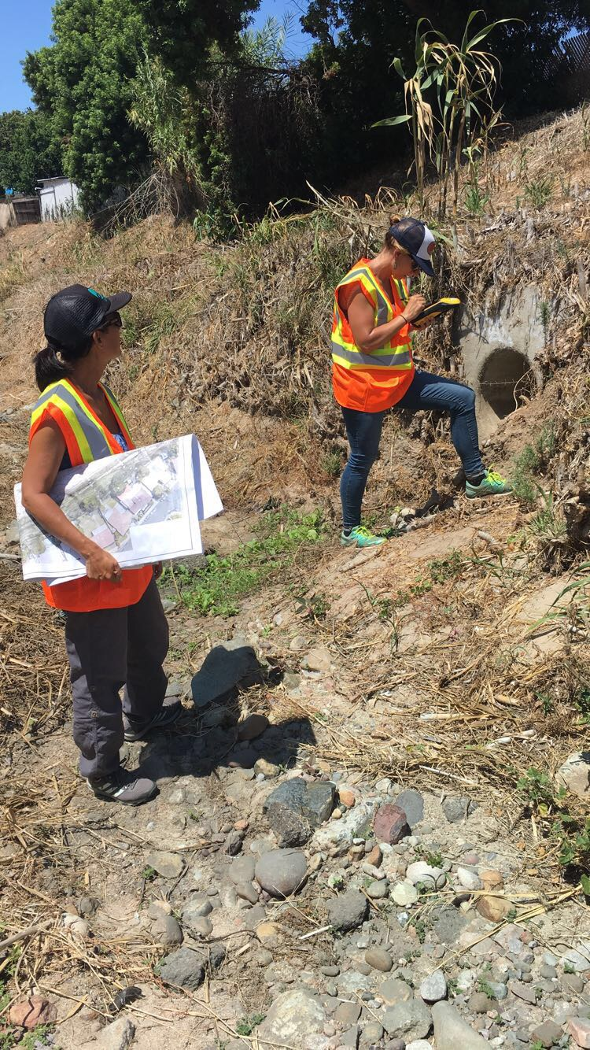
Thank you
Paradise Creek Water Quality & Community Enhancements Project
Who we are: Harris & Associates, Inc. www.WeAreHarris.com

